Slide 1
Math 319 Final Automatic Differentiation
By: Christopher Berglund, Pierre Visconti,
Benjamin Wachter

Slide 2


What is Automatic Differentiation
$$y=f\left(g\left(h\left(x\right)\right)\right)=f\left(g\left(h\left(w_{0}\right)\right)\right)=f\left(g\left(w_{1}\right)\right)=f\left(w_{2}\right)=w_{3} \\ w_{0}=x \\ w_{1}=h\left(w_{0}\right) \\ w_{2}=g\left(w_{2}\right) \\ w_{3}=f\left(w_{2}\right)=y$$
Fundamental to automatic differentiation is the decomposition of differentials provided by the chain rule of partial derivatives of composite functions. For the simple composition
$$\frac{∂y}{∂x}=\frac{∂y}{∂w_{2}}\frac{∂w_{2}}{∂w_{1}}\frac{∂w_{1}}{∂x}=\frac{∂f\left(w_{2}\right)}{∂w_{2}}\frac{∂g(w_{1})}{∂w_{1}}\frac{∂h(w_{0})}{∂x}$$

Slide 3
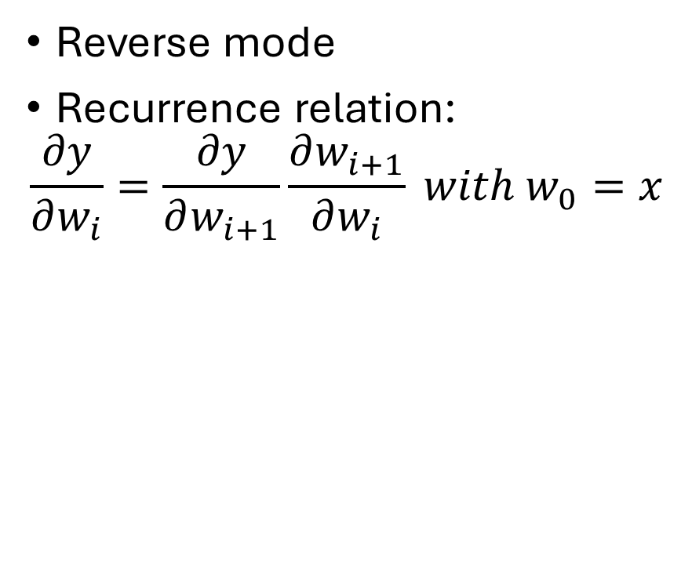
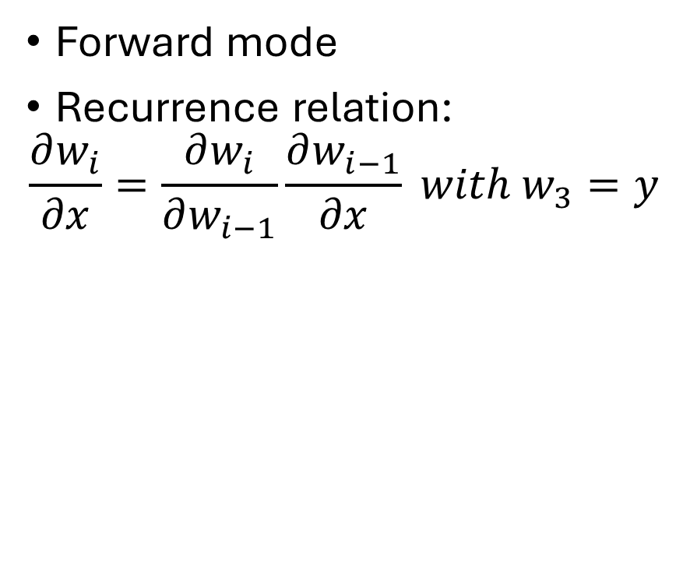
Two main methods
Forward mode
Recurrence relation:
$$\frac{∂w_{i}}{∂x}=\frac{∂w_{i}}{∂w_{i−1}}\frac{∂w_{i−1}}{∂x} with w_{3}=y$$
Reverse mode
Recurrence relation:
$$\frac{∂y}{∂w_{i}}=\frac{∂y}{∂w_{i+1}}\frac{∂w_{i+1}}{∂w_{i}} with w_{0}=x$$

Slide 4
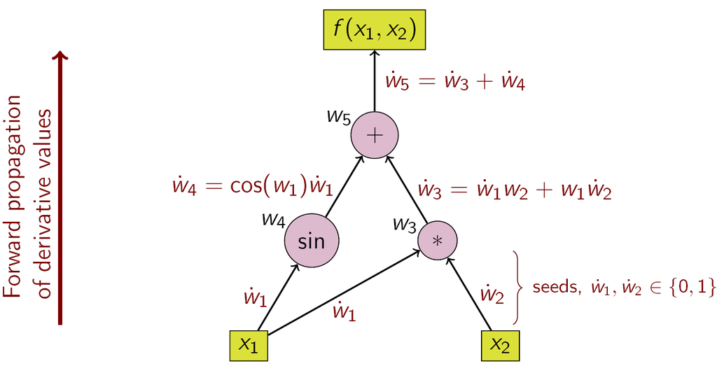
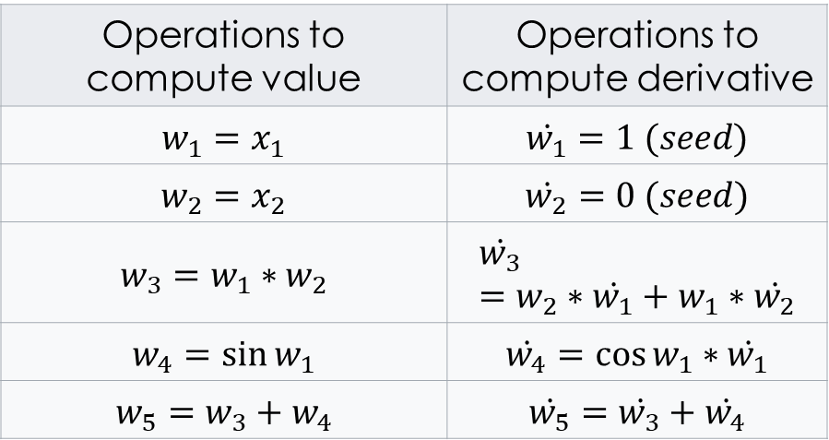
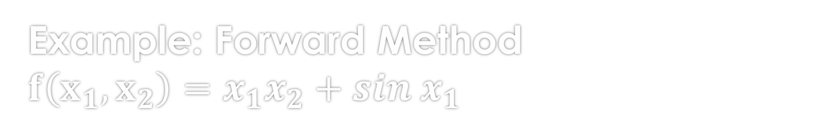
Example: Forward Method $$f\left(x_{1},x_{2}\right)=x_{1}x_{2}+sin x_{1}$$
Operations to compute value | Operations to compute derivative
$$w_{1}=x_{1}$$ | $$\dot{w_{1}}=1 (seed)$$
$$w_{2}=x_{2}$$ | $$\dot{w_{2}}=0 (seed)$$
$$w_{3}=w_{1}∗w_{2}$$ | $$\dot{w_{3}}=w_{2}∗\dot{w_{1}}+w_{1}∗\dot{w_{2}}$$
$$w_{4}=\sin{w_{1}}$$ | $$\dot{w_{4}}=\cos{w_{1}}∗\dot{w_{1}}$$
$$w_{5}=w_{3}+w_{4}$$ | $$\dot{w_{5}}=\dot{w_{3}}+\dot{w_{4}}$$

Slide 5
Application
Automatic differentiation is particularly important in the field of machine learning. For example, it allows one to implement backpropagation in a neural network without a manually-computed derivative.

